Slide 1

This curriculum is available on the NWABR website, http://www.nwabr.org
Permission granted for educational use
©2012 Northwest Association for Biomedical Research
^{All Rights Reserved}

Slide 2
Lesson 3
The Social Nature of Science

Slide 3
Science through the Centuries
The 1700s
The Nature of Scientific Research
Northwest Association for Biomedical Research
Notes:
All images from Wellcome Images. Images on this site are freely available for download for personal, academic teaching, or study use, under one of two Creative Commons licenses.

Slide 4
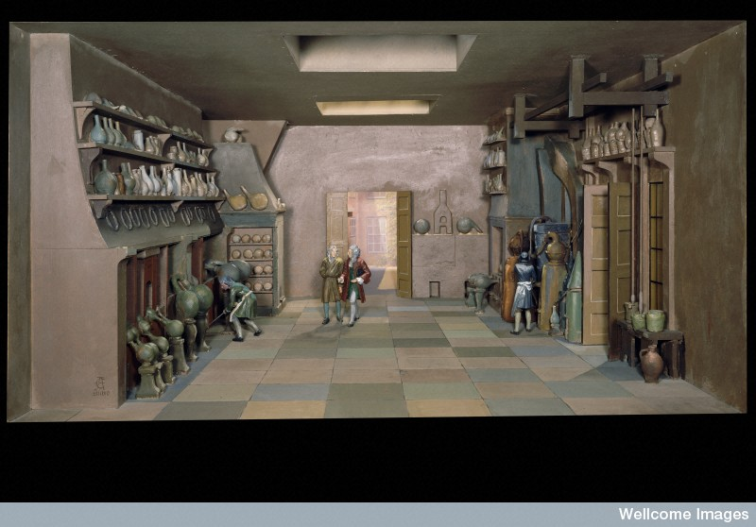
Chemistry Lab
Wellcome Images
Notes:
Ambrose Godfrey Hanckwitz (1660-1741), a German chemist, set up a drug making laboratory (much like the one in this diorama) in London, 1680. Large furnaces and chemical equipment line the room. Ambrose Godfrey, as he became known, was an assistant to Robert Boyle (1627-1691), an Irish chemist. After Boyle discovered a way of making solid phosphorous in 1680, Godfrey made this the basis of his drug manufacturing business and held the monopoly over this ingredient for forty years. Godfrey’s business went on to become Godfrey & Cooke, a firm of chemists still in business at the beginning of the 1900s. Godfrey also researched spa waters, which were believed to have curative properties.
Maker: Unknown maker.
Place made: England, United Kingdom.
L0058040 Credit: Science Museum, London, Wellcome Images.

Slide 5
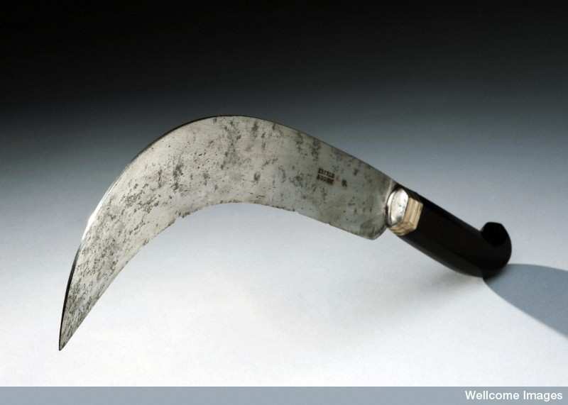
Wellcome Images
Notes:
The curved shape of this amputation knife was common in the early 1700s. Amputation knives became straighter once the practice of leaving a flap of skin to cover the limb stump became the preferred amputation method. Ebony was a common material for handles as it is a hard-wearing wood. This knife was probably made by Eberle in Germany, as indicated by the inscription on the silver blade.
L0058145 Credit: Science Museum, London, Wellcome Images.

Slide 6
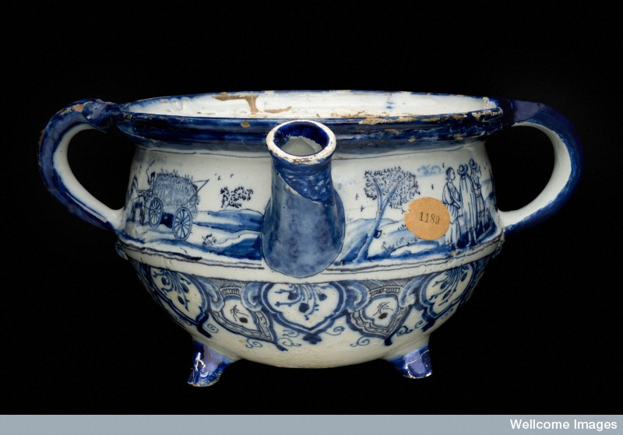
Wellcome Images
Notes:
Chamber pots were used in the home or hospitals at a time when most toilets were outside – or non-existent. In the 1700s, chamber pots were often emptied out of windows straight into the street, sometimes with the cry “gardy loo” (from the French gardez l’eau, or “watch for the water”).
The blue and white design indicates that the chamber pot is probably from the Netherlands. The design shows country scenes, including a maid milking a cow.
L0057044 Credit: Science Museum, London, Wellcome Images.

Slide 7
Science through the Centuries
The 1800s
The Nature of Scientific Research
Northwest Association for Biomedical Research

Slide 8
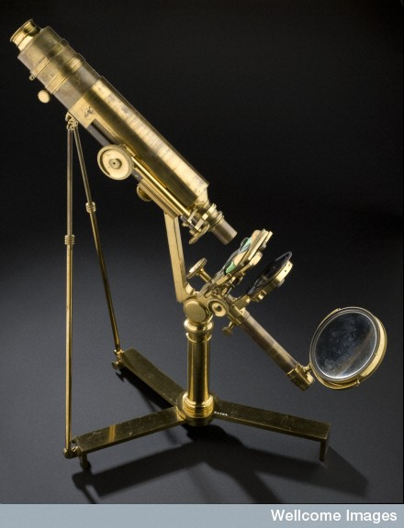
Wellcome Images
Notes:
Joseph Jackson Lister's microscope, London, England, 1826 made by James Smith, London, 1826.
L0057210 Credit: Science Museum, London, Wellcome Images.

Slide 9
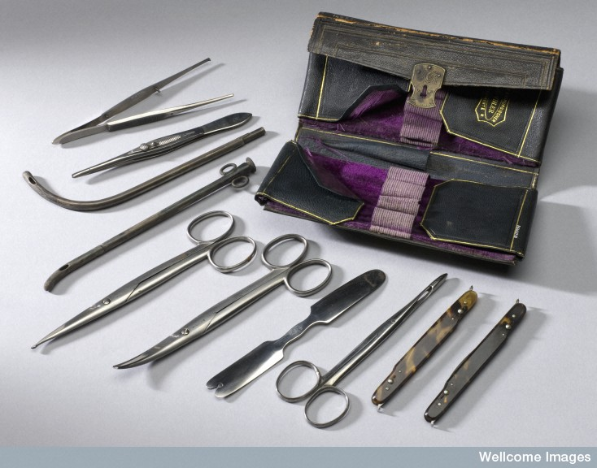
Wellcome Images
Notes:
This instrument set is easily portable, designed to fit into a surgeon’s or physician’s pocket. It contains two folding scalpels in tortoiseshell cases, a bistoury, a catheter, a tongue depressor, scissors, ophthalmic forceps, forceps for applying bandages, and a needle holder.
L0058741 Credit: Science Museum, London, Wellcome Images.

Slide 10
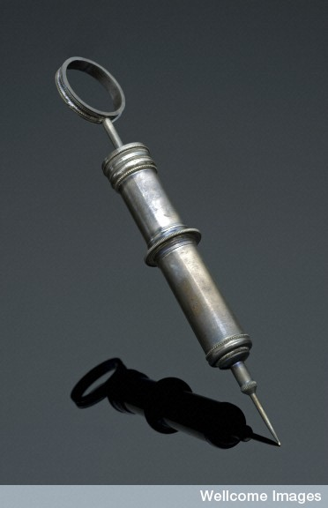
Wellcome Images
Notes:
Hypodermic needles came into common use in the second half of the 1800s. They were invented by Scottish doctor Alexander Wood in 1853 – although French surgeon Charles Pravaz was independently developing a similar device at the same time.
Hypodermic needles like these are hollow so drugs can be injected directly into the body. This particular example has a glass barrel with a scale scratched on to the outside to measure how much was being given to the patient. The metal case is personalized with the initials “HC” engraved on the side, possibly indicating the case’s owner. The case contains one spare needle, although there is also room for another needle and three spare barrels.
Maker: Unknown maker.
L0057803 Credit: Science Museum, London, Wellcome Images.

Slide 11
Science through the Centuries
The 1900s
The Nature of Scientific Research
Northwest Association for Biomedical Research

Slide 12
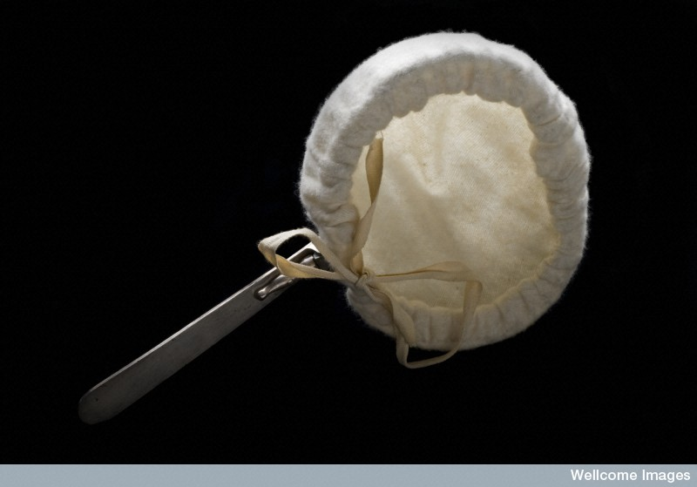
Anesthesia mask for chloroform or ether,
early 1900s
Wellcome Images
Notes:
Thomas Skinner (1825-1906), a gynecologist working in Liverpool, later specialized in anesthetics and introduced this flannel covered wire mask in 1862. It was a new and easy way of giving pain relief. It could be used for either chloroform or ether, which would have been in liquid form and dropped on to the mask for the patient to inhale. The mask needed an extra nose clip to ensure that the patient inhaled the entire dosage of pain killer. Skinner’s mask was popular into the 1900s and was easily portable.
L0057830 Credit: Science Museum, London, Wellcome Images.

Slide 13
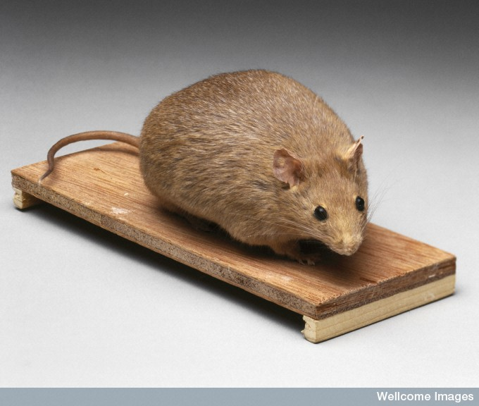
Bioengineered obese mouse, 1998
Wellcome Images
Notes:
What use is a fat mouse? Mice of all colors, shapes, and sizes were bred for fun in China and Japan in the 1600s. Victorian Britain also had a ‘mouse craze’, with the foundation of the National Mouse Club – by humans – in 1895. Breeders competed for prizes for new varieties of fancy mice with names like ‘red cream’, ‘ruby-eyed yellow’, and ‘creamy buff’.
But what has this got to do with science? The new varieties were highly desirable, and mouse fanciers were creating masses of genetically identical mice. Since the early 1900s scientists have used some of these mice to investigate heredity and disease.
In the 1950s, scientists discovered a strain (a genetic variation) of unusually obese mice, but toiled for several decades to find out why they were so fat. Thirty years later a team led by Dr. Jeffrey Friedman discovered that the mice were lacking a particular gene. In normal animals, this gene produced a protein called leptin that told the mouse when to stop eating. Without leptin it kept on eating, growing fatter and fatter. When Friedman gave the obese mice leptin they lost weight.
L0060083 Credit: Science Museum, London, Wellcome Images.

Slide 14
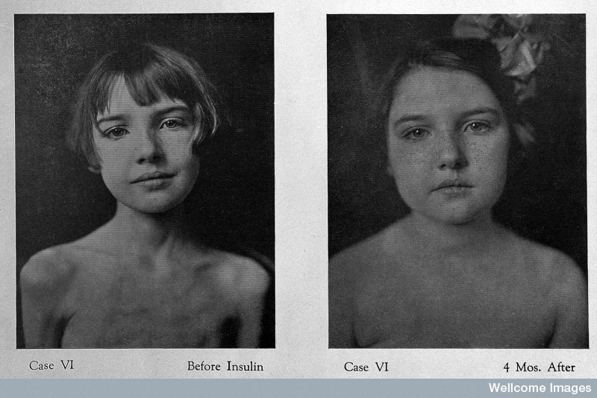
Before and after insulin treatment, 1922
Wellcome Images
Notes:
Credit: Geyelin, H.R. (1922). The use of insulin in juvenile diabetes. Journal of Metabolic Research. Morristown, NJ: Psychiatric Institute.

Slide 15
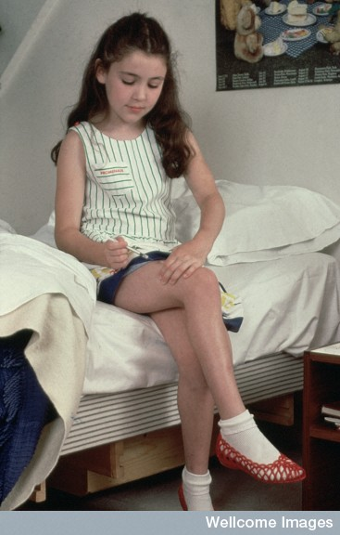
Wellcome Images
Notes:
Insulin injecting, Diabetes. 1970s to 1986.
N0008871 Credit: Wellcome Images.

Slide 16
Science through the Centuries
The 2000s
The Nature of Scientific Research
Northwest Association for Biomedical Research

Slide 17
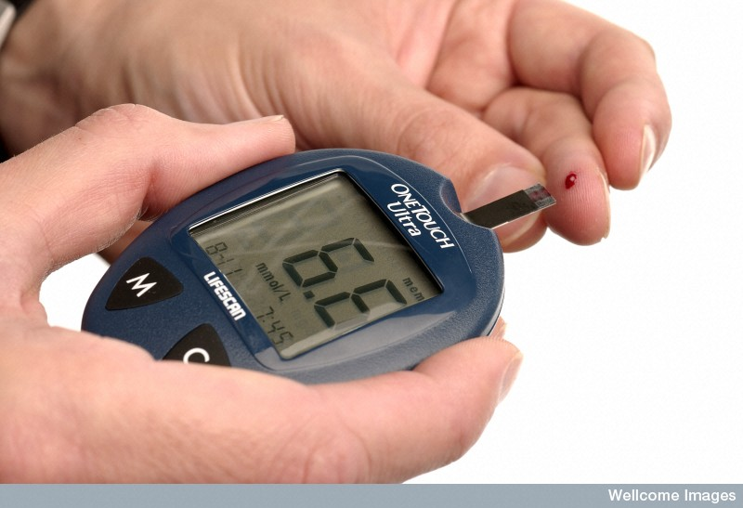
Wellcome Images
Notes:
A man with diabetes using an electronic reader to measure the level of sugar in his blood from a drop on his finger. This reading of 6.6 mmol/L is a normal reading so he does not need to take any action at this point. A normal blood glucose level should be above 3.5 and below 10 mmol/L.
Credit: Wellcome Images, 2006.

Slide 18
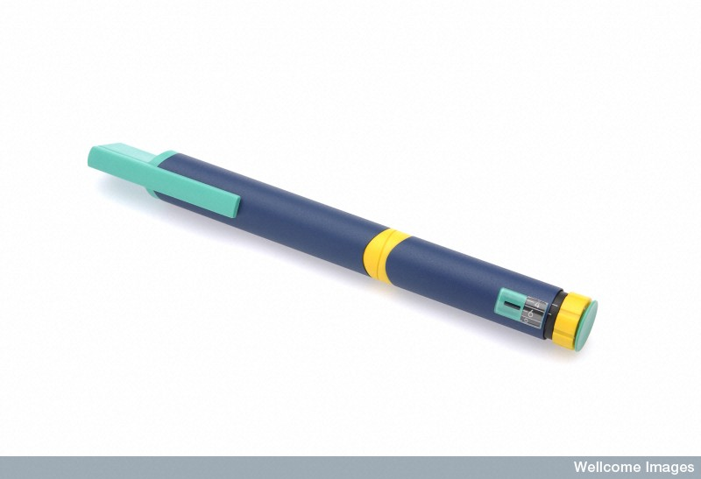
Wellcome Images
Notes:
An injection "pen" with a fine needle for people with diabetics to regulate their blood glucose level using insulin. It allows the diabetic to easily set the amount of insulin they need with the number scale on the end.
N0029209 Credit: Science Museum, London, Wellcome Images. 2006.

Slide 19
Science through the Centuries
The Citizens
The Nature of Scientific Research
Northwest Association for Biomedical Research

Slide 20
CITIZEN OF THE 1700s
My name is Mary Walker and I am a typical citizen of the 1700s. I am 16 years old. I have two older sisters, a younger brother, and two siblings who died as babies. Most people are farmers, and many boys go to school, at least for a few years. I was taught some at home, but many of my friends don’t know how to read or write. If my brother wants more school, he’ll have to go into the ministry because the church supports most education. This isn’t likely, though, because somebody will have to take over the family farm.

Slide 21
CITIZEN OF THE 1800s
My name is Samuel Christian and I am a typical citizen of the 1800s. I am an old man at the age of 52. I am a farmer, but our family’s land was not big enough to support everybody, so my younger brothers and their families moved to the city years ago to work in a factory. They are making a living, but I hear that they are live crammed together in one small apartment. I can read and write some, but it’s mostly the landowners and wealthy people who are truly “educated” since they are the only people who can afford it. I’ve heard that free public elementary education might be available for all American children soon—now that more people are moving to cities, some people think that free education will create good citizens, unite society and prevent crime and poverty.

Slide 22
CITIZEN OF THE 1900s
My name is Pearl McKinley and I am a citizen of the 1900s. I’m 96 now and I’ve seen a lot of changes! I grew up on a small family farm, but now most people rely on manufacturing jobs. Think of all the things that have been invented in my lifetime: television, credit cards, cell phones, dishwashers, contact lenses, ball point pens, frozen pizza, cars, microwave ovens, CDs, computers, fast food…the list goes on and on. When I was born, only about 6 percent of the population graduated from high school. Now, about 85 percent do! More and more people go to college now, too. Every child in the U.S. can get a free education now, at least though high school, because public schools are supported by the government.

Slide 23
CITIZEN OF THE 2000s
My name is Andrew Hayes and I am a typical citizen of the 2000s. In the U.S. now, most workers provide some sort of service like health care, education, business or retail. In developing countries, many people farm, though other types of jobs are becoming more common as developed countries move industries overseas. In the US, most people graduate from government-supported public high school, and the majority go on to college or trade school, too, though they may have to pay for part or all of it. Online education is becoming more popular and people now get a lot of their information through technology.

Slide 24
Science through the Centuries
The Medical Practitioners
The Nature of Scientific Research
Northwest Association for Biomedical Research

Slide 25
MEDICAL PRACTITIONER OF THE 1700s
My name is Isaac Dawson and I practice medicine. Many people in our community (about one in three) die as infants or toddlers. If you live to be a teenager, you have a good chance of living to be as old as 50 or 60. Most of my patients die of small pox, cholera, bubonic plague, scarlet fever, or tuberculosis. I believe that illness is caused by bad air or an imbalance of blood, phlegm, yellow bile and black bile in the body. I use treatments that have been around for thousands of years, such as herbs, suction cups and “bleeding” to cure disease.

Slide 26
MEDICAL PRACTITIONER OF THE 1800s
My name is Joseph Lister, and I am a well-educated surgeon. Most people of this time die from diseases such as smallpox, cholera, scarlet fever, or tuberculosis. As a surgeon, I see a lot of women and babies die from infections after childbirth. I have heard of Louis Pasteur’s work with “germs” and think they could be the cause of infection, not chemical changes due to “bad air” as most people think. Right now, many of the surgeons I work with don’t even wash their tools or hands between surgeries. I’m now working on an antiseptic to kill germs on surgical tools, which may reduce infections from operations. Thanks to microscopes, one of my colleagues has discovered that both tuberculosis and cholera are caused by small living things—bacteria.
[Note: the popular antiseptic mouthwash Listerine is named after Joseph Lister.]

Slide 27
MEDICAL PRACTITIONER OF THE 1900s
My name is Alexander Fleming and I am a medical doctor. It’s not uncommon now for people to live until their mid-70s or later, at least in developed countries. During World War I, I saw how easily deep wounds became infected, even though we used sterilization techniques developed by Joseph Lister and others in the 1800s. After the war, I began looking for antibacterial agents that would lead to a treatment. After accidentally leaving bacteria cultures to mold, I noticed that the colonies closest to the mold had been destroyed. This led to the discovery of penicillin which has become the first antibiotic and has eventually led to treatments for scarlet fever, cholera, tuberculosis, bubonic plague, and other diseases. I, Alexander Fleming, will die of a heart attack as will many others. Chronic diseases involving the heart and respiratory systems will take their toll as people live longer. Cancer will also affect people all over the world.

Slide 28
MEDICAL PRACTITIONER OF THE 2000s
My name is Dr. Douglas Lowy. Our global life expectancy is about 67 years, though it is not uncommon for people in developed countries to live into their nineties. After studying art history, French and getting my medical degree, I began a career in basic science research at the National Cancer Institute (NCI). My work eventually led to two vaccines for cervical cancer.
I am familiar with the work of Dr. Nora Disis, who is also working with cancer vaccines. All my work is federally funded through the NCI. As people are living longer, chronic diseases are the source of many health issues. Worldwide, the top health-related causes of death are heart disease and stroke, respiratory infections, pulmonary disease, diarrheal disease, and HIV/AIDS. Diabetes is the ninth cause of death globally. More health concerns are related to diet and access to healthy foods and clean water.

Slide 29
Science through the Centuries
The Scientists
The Nature of Scientific Research
Northwest Association for Biomedical Research

Slide 30
SCIENTIST OF THE 1700s
My name is Robert Hooke. I was educated at home in England by my father, a churchman, and sent away to school at the age of 13. I am an old man now, but I’ve seen lots of scientific advancements. Our lens grinding techniques are now good enough to make two important research tools: telescopes and microscopes. Using a microscope, I was able to see very small things such as plant “cells.” The public doesn’t always understand my work, though, and I have been publicly ridiculed for spending so much money on microscopes just to see “mites in cheese.” I think this is important work that may change science and medicine!

Slide 31
SCIENTIST OF THE 1800s
My name is Louis Pasteur and I am the son of a French tanner. My wife and I had five children, but three of them died of typhoid. After that heartache, I have dedicated my life to curing disease, and I would like to thank my university, which often gave me financial support for my studies. Many people still think that disease is caused by bad air, but I have proven that disease is caused by microscopic organisms. I’m calling them “germs.” I think these germs are also responsible for spoiling milk and beer. I’m now working on a vaccination for rabies and for anthrax, which kill many domestic animals. Without microscopes and people like Robert Hooke who pioneered them, I wouldn’t be able to do this work.
[Note: The process of pasteurizing milk is named after Louis Pasteur.]

Slide 32
SCIENTIST OF THE 1900s
My name is Jonas Salk and I was born to immigrants who were determined that I would have a good education. I went to public schools and was the first in my family to go to college. I attended a college in New York for students from working class, immigrant families, then on to medical school. During work on a project funded by a foundation (known as the March of Dimes), my research team and I developed the first effective vaccine against polio. Other researchers developed vaccines for small pox, measles, mumps, rubella, and many other diseases reducing deaths and disfigurement drastically during this time period. We are all building on the early vaccine work of Louis Pasteur and others.

Slide 33
SCIENTIST OF THE 2000s
My name is Dr. Nora Disis and I am a medical doctor and researcher interested in women’s health, specifically breast and ovarian cancer.
I discovered a tumor antigen which led me to develop cancer vaccines.
In the past, vaccines made by famous researchers like Jonas Salk (1900s) fought infectious diseases like smallpox and polio, so my work using vaccines against cancer is pretty new! I work with the Tumor Vaccine Group in Seattle and rely on research grants from the U.S. government along with many other places to fund my work.

Slide 34
Science through the Centuries
The People
with Diabetes
The Nature of Scientific Research
Northwest Association for Biomedical Research

Slide 35
PERSON WITH DIABETES IN THE 1700s
My name is Elizabeth Snell and I am 27 years old. My husband is a farmer. I’ve had eight children, though only four are living now – one boy and three girls. One baby died before he was a week old, and I lost two children to smallpox when it spread through our village this year. My second son, though, that was the strangest thing. William was always hungry and we could hardly get enough food to feed him, but he stayed so skinny. He complained all the time of being tired and one day couldn’t get out of bed. Maybe his body had too much black bile, I don’t know. One evening we couldn’t wake him up and by morning he was gone.

Slide 36
PERSON WITH DIABETES IN THE 1800s
Hello, I am Mary Roberts and I am 14 years old. My father is a banker. My mother mostly entertains, but lately she hasn’t even been doing that. That’s because my eight year old sister got sick. The doctor came a couple of months ago and he said she has the diabetes. Since then, they have tried giving her opium and bleeding her with leeches. Now, the doctor won’t let my mother feed her hardly anything – just some broth and black coffee. I’m not allowed to go in her room any more but I peeked in this morning. She doesn’t look good! Her eyes are closed and she is real skinny.

Slide 37
PERSON WITH DIABETES IN THE 1900s
My name is James Walker. I am 25 years old. I was diagnosed with diabetes when I was 16 years old, in 1948. Doctors now know that diabetes is caused by a lack of insulin, so I watch what I eat and use insulin to control my blood sugar, which is really difficult. I have to give myself insulin shots several times a day, then the needle and syringe need to be washed and sterilized in boiling water. It’s a big needle, too! I even have to sharpen it regularly. The only way to really know my blood sugar levels is to go to the hospital. Once I got a sore on my foot that turned into an ulcer, and I didn’t even know it! The doctor said if I had waited any longer to see him I might have lost my foot. At least I’m not allergic to the insulin I use; I’ve read about some people who are.

Slide 38
PERSON WITH DIABETES IN THE 2000s
My name is Aubrey Mathwig. I am 25 years old and have Type 1 Diabetes.
I was diagnosed a few years ago when I was drinking two gallons of water every day but was extremely thirsty at all hours. I also was losing weight rapidly and was exhausted all the time. Things in my life have changed since then. First, I have to monitor my blood sugar throughout the day, every day, which can get tedious. I also have to give myself a shot of insulin each time before I eat, and once before bed. I have to be prepared at all times by traveling with insulin, needles, etc., along with a fast-acting carbohydrate in case my blood sugar gets low. Even with this disease, my future is bright as long as I keep on top of my blood sugar levels consistently and take good care of myself.

Slide 39
Science through the Centuries
Closing Thoughts
The Nature of Scientific Research
Northwest Association for Biomedical Research

Slide 40
A satirist from the 1700s described Robert Hooke as…
“a Sot, that has spent £2000 in Microscopes, to find
out the nature of Eels in Vinegar, Mites in Cheese,
and the Blue of Plums which he has subtly found
out to be living creatures."
How did Robert Hooke’s discoveries affect others in the years to come?
Notes:
Credit: Waggoner, B. (2001, January 20). Robert Hooke (1635-1703). Retrieved from http://www.ucmp.berkeley.edu/history/hooke.html

Slide 41
How does this quote pertain to today’s lesson?
“If I have seen further,
it is by standing on the
shoulders of giants.”
-Attributed to Sir Isaac Newton
Notes:
Some teachers suggest that this question be used as an “exit ticket” for the lesson.

