Slide 1
Rare Film Guide Slide Set

Slide 2
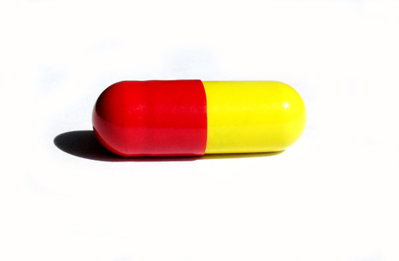
Clinical Trial Design for Pirfenidone Study
Purpose of Study:
To see if the use of pirfenidone decreases the loss of lung function better than placebo, and to find out how safe pirfenidone is compared to placebo.
versus

Slide 3
Inclusion Criteria (all of these conditions must be met)
Diagnosis of HPS
Male or female over the age of 18
Lung capacity test results within set range
No evidence of improvement in pulmonary fibrosis within the past year
Have oxygen levels within set range during a 6-minute walk test
Be available, willing, and able to come to the NIH Clinical Center in Maryland for tests and follow-up every 4 months for three years
Women of child-bearing potential must use two reliable forms of contraception if sexually active. Alternatively, female subjects must be postmenopausal (for at least 1 year). Women must have a negative pregnancy test at screening.

Slide 4
Exclusion Criteria (any of these conditions would disqualify someone from participation)
Possibility of having pulmonary fibrosis for reasons other than HPS (such as through exposure to asbestos, radiation, cancer, certain types of pneumonia)
On a lung transplantation waiting list
Smoking within last 6 months
Pregnant or nursing women
History of alcohol abuse or recreational drug use in the past two years
History of human immunodeficiency virus (HIV) or chronic viral hepatitis infection
Chronic use of high-dose steroids
Prior use of pirfenidone

Slide 5
Clinical Trial Design for Pirfenidone Study
Qualified study participants begin by signing consent forms
Randomization:
Participants are randomly chosen to receive the pirfenidone or the placebo.
Participants receive a total of 800 mg of pirfenidone in three pills daily.
Participants receive a placebo taken in three pills daily
Double Blind Study: Neither the participants nor the researchers know which treatment the participant is receiving. This is done to prevent bias.

Slide 6
Clinical Trial Design for Pirfenidone Study
Participants receive a total of 800 mg of pirfenidone in three pills daily.
Participants receive a placebo taken in three pills daily
Lung function and other factors are checked; side effects are noted.
Periodic checks for three years.
Lung function and other factors are checked; side effects, are noted.
Follow-up and analysis of data for safety and efficacy.
Follow-up and analysis of data for safety and efficacy.
Efficacy: How does the drug treatment work compared to the placebo?

Slide 7
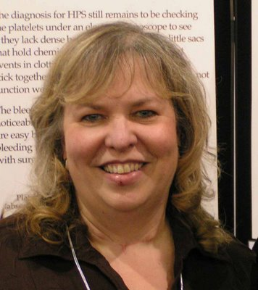
Stakeholders in the film Rare
Donna’s daughter, Ashley, was diagnosed with HPS when she was a toddler. Donna worked to find others with the condition and founded the HPS Network in 1992. Ashley is now in her twenties and Donna has over 700 patients in her database.
Donna Appell

Slide 8
Stakeholders in the film Rare
Heather was in her twenties before a physician suggested she might have HPS, though she had had symptoms all her life. Heather is a journalist, advocate for people with HPS, and a participant in the clinical trial shown in the film.
Heather Kirkwood

Slide 9
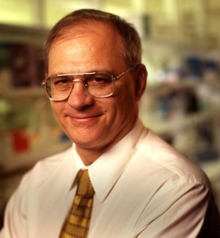
Stakeholders in the film Rare
Dr. Gahl works in the Office of Rare Disease Research at the National Institutes of Health. He is both an MD and a PhD and works as a physician and clinical researcher for rare diseases such as HPS. He is head of the clinical trial shown in the film.
William Gahl

